Slide 1

FOOTWEAR PRODUCTS e-STORE DATABASE

Slide 2
TEAM-1
Navyasree Sriramoju (Team Leader)
Sushmitha Dandu (Database Developer)
Naga Sai Lohitha Karmuru (Database Designer)

Slide 3
AGENDA
Introduction
Purpose
Functionality and Operations
Lessons Learnt
SQL: Structured Query Language
PL/SQL: Procedural Language Extension to structured query language
ORDBMS: Object-relational database management system
Lessons Learnt from Project Development
Room for Improvement

Slide 4
INTRODUCTION
Footwear stores are retail establishments that offer shoes and other footwear items. They can be found in retail malls, commercial areas, and online platforms, and they cater to customers of all ages, genders, and styles.
The main goal is to develop a comprehensive and efficient database system to support the operations of an online footwear store. The database will be built to manage many parts of the e-store, such as product management, customer information, order processing, and inventory management.

Slide 5
PURPOSE
The project's major goal is to ensure effective and reliable data management for the e-store. Creating tables with proper constraints to contain product information, customer data, and order details, as well as assuring data quality and security. Inventory management will also be handled by the database, which will keep track of available stock and update it in real-time as orders are placed and fulfilled.
Another critical goal of the project is to improve data retrieval and reporting for the e-store. Defining views that provide meaningful and relevant information to store management, such as sales reporting, order tracking, and customer analytics, is part of this.

Slide 6
FUNCTIONALITY AND OPERATIONS
The documentation for the Footwear products online shop database contains thorough information about the database's entity types, relationships, and properties. This data assists users in understanding how data is arranged and kept in the database.
The documentation also describes data validation rules and constraints to ensure that the data in the database is accurate and consistent. Defining data types, allowable values, and business rules to validate incoming data are all part of this.

Slide 7

LESSONS LEARNT
Efficient inventory management is key: The database must be designed to handle inventory management efficiently, allowing the e-store to monitor stock levels, track sales, and automatically update inventory levels in real-time.
Accurate and comprehensive product data is critical: To ensure a good user experience, the product data in the database must be accurate, up-to-date, and comprehensive. This means including all the relevant information about each product, such as size, color, materials, price, and availability.

Slide 8
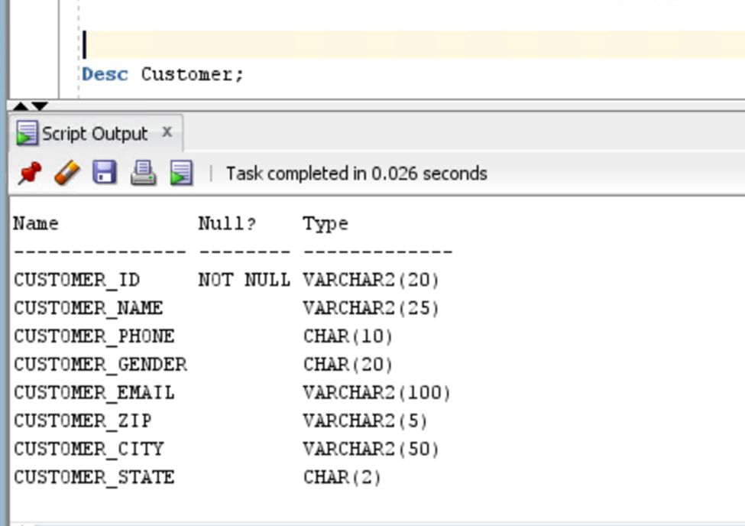
SQL: Structured query language Creating Tables
DROP TABLE Customer CASCADE CONSTRAINTS;
CREATE TABLE Customer
(
Customer_Id VARCHAR2(20) NOT NULL,
Customer_Name VARCHAR2(25),
Customer_Phone CHAR(10),
Customer_Gender CHAR(20),
Customer_Email VARCHAR(100),
Customer_Zip VARCHAR(5),
Customer_City VARCHAR(50),
Customer_State CHAR(2),
CONSTRAINT Customer_PK PRIMARY KEY(Customer_Id),
CONSTRAINT Customer_UK_Customer_Phone UNIQUE (Customer_Phone),
CONSTRAINT Customer_NN_Customer_Name CHECK (Customer_Name IS NOT NULL)
);

Slide 9
Inserting Values
INSERT INTO Customer VALUES(1,'John Smith','1234567890','M','john@gmail.com','32601','New York','NY');
INSERT INTO Customer VALUES(2,'Jane Johnson','9876543210','F','jane@gmail.com','75094','Los Angeles','CA');
INSERT INTO Customer VALUES(3,'Micheal Lee','4567890123','M','micheal@gmail.com','12209','Chicago','IL');
INSERT INTO Customer VALUES(4,'Sarah Brown','7890123456','F','sarah@gmail.com','07008','Houston','TX');
INSERT INTO Customer VALUES(5,'David Kim','3456789012','M','david@gmail.com','94206','San Francisco','CA');
INSERT INTO Customer VALUES(6,'Jessica Chen','9012345678','F','jessica@gmail.com','80514','Miami','FL');
INSERT INTO Customer VALUES(7,'Brian Johnson','6789012345','M','brian@gmail.com','97954','Seattle','WA');
INSERT INTO Customer VALUES(8,'Emily Davis','2345678901','F','emily@gmail.com','96915','Atlanta','GA');
INSERT INTO Customer VALUES(9,'Matthew Wilson','5678901234','M','matthew@gmail.com','34620','Dallas','TX');
INSERT INTO Customer VALUES(10,'Olivia Anderson','8901234567','F','olivia@gmail.com','34646','Boston','MA');
INSERT INTO Customer VALUES(11,'James Taylor','1232345644','M','james@gmail.com','07508','San Diego','CA');
INSERT INTO Customer VALUES(12,'Ava Martinez','1238799032','F','ava@gmail.com','49015','Philadelphia','PA');
INSERT INTO Customer VALUES(13,'Benjamin Lee','2512346788','M','benjamin@gmail.com','17013','Phoenix','AZ');
INSERT INTO Customer VALUES(14,'Mia Brown','4347897689','F','mia@gmail.com','96744','Denver','CO');
INSERT INTO Customer VALUES(15,'Ethan Kim','3467542345','M','ethan@gmail.com','84403','Portland','OR');

Slide 10
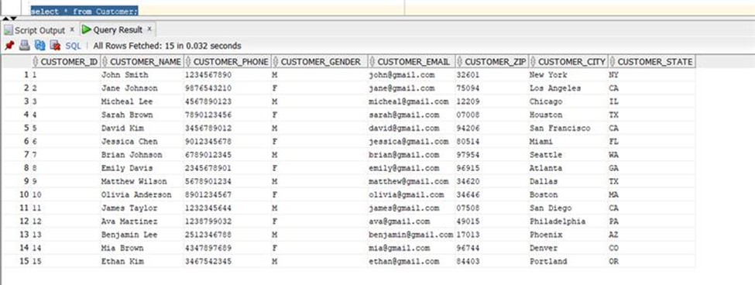
Selecting All from Table:
SELECT * FROM Customer;

Slide 11
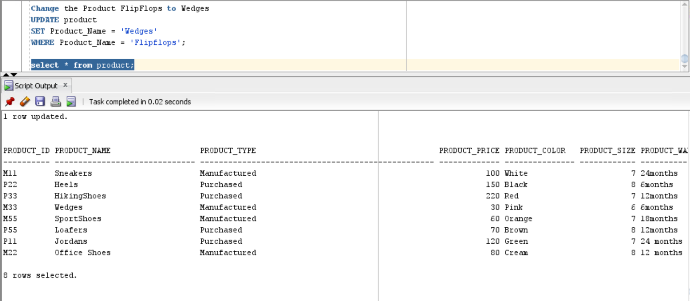
Performing Update
Updating Product_Name from Flipflops to Wedges in Product Table.
Change the Product FlipFlops to Wedges
UPDATE product
SET Product_Name = 'Wedges'
WHERE Product_Name = 'Flipflops';

Slide 12
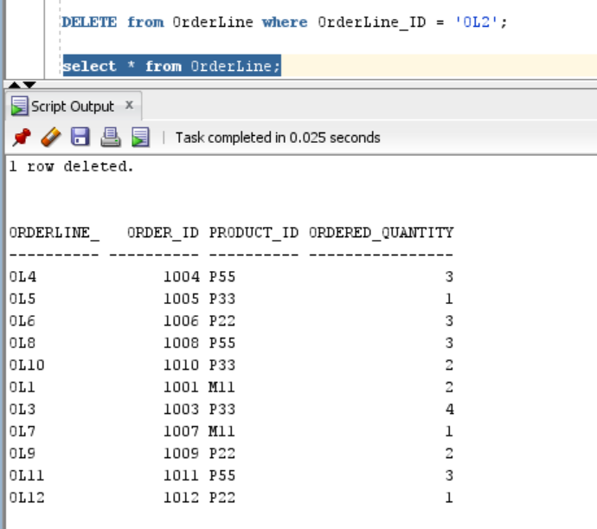
Performing Delete
Deleting OL2 values from OrderLine Table.
DELETE from OrderLine where OrderLine_ID = 'OL2';

Slide 13
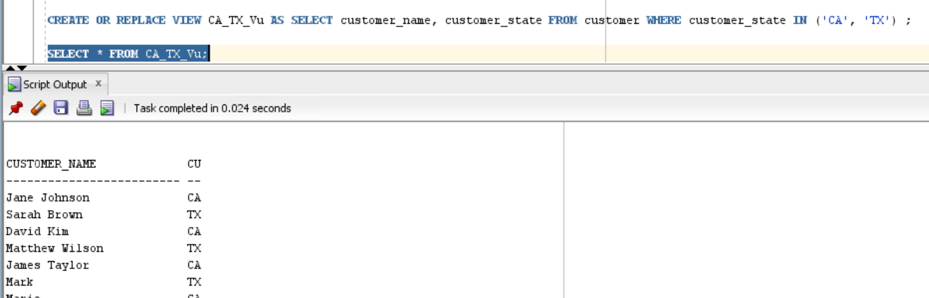
Performing Create View
Creating a view for Customer in states California and Texas:
CREATE OR REPLACE VIEW CA_TX_Vu AS SELECT customer_name, customer_state FROM customer WHERE customer_state IN ('CA', 'TX');
SELECT * FROM CA_TX_Vu;

Slide 14
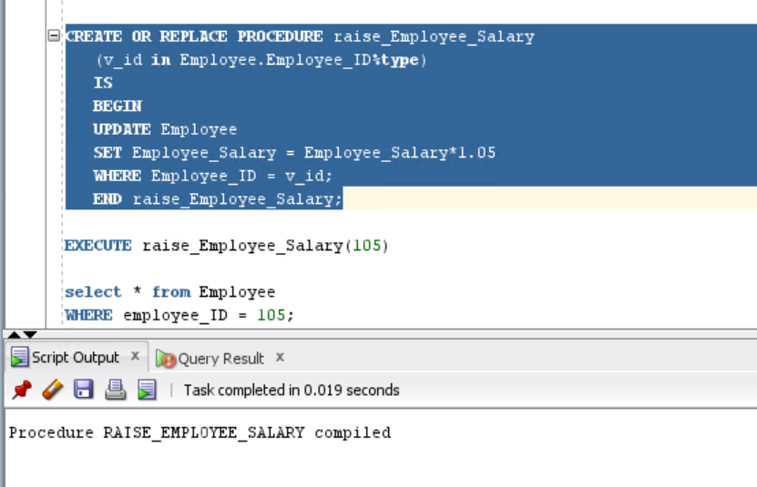
PL/SQL: Procedural Language Extension to structured query language
Raise Employee Salary by 5%:
CREATE OR REPLACE PROCEDURE raise_Employee_Salary
(v_id in Employee.Employee_ID%type)
IS
BEGIN
UPDATE Employee
SET Employee_Salary = Employee_Salary*1.05
WHERE Employee_ID = v_id;
END raise_Employee_Salary;

Slide 15
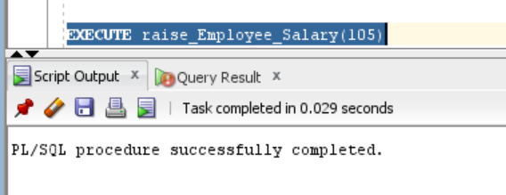
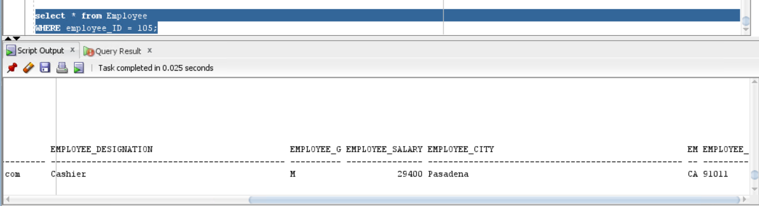
PL/SQL Cont.
EXECUTE raise_Employee_Salary(105)
select * from Employee
WHERE employee_ID = 105;

Slide 16
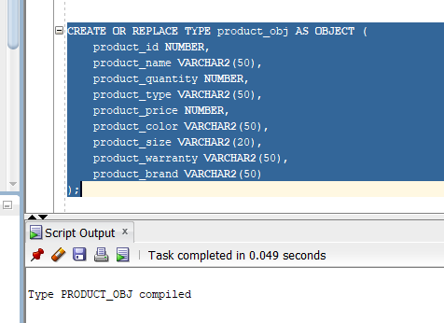
ORDBMS: Object-relational database management system
Creating ORDBMS object type for Product table:
CREATE OR REPLACE TYPE product_obj AS OBJECT (
product_id NUMBER,
product_name VARCHAR2(50),
product_quantity NUMBER,
product_type VARCHAR2(50),
product_price NUMBER,
product_color VARCHAR2(50),
product_size VARCHAR2(20),
product_warranty VARCHAR2(50),
product_brand VARCHAR2(50)
);

Slide 17
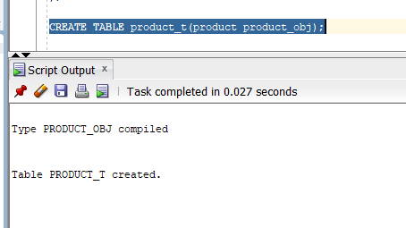
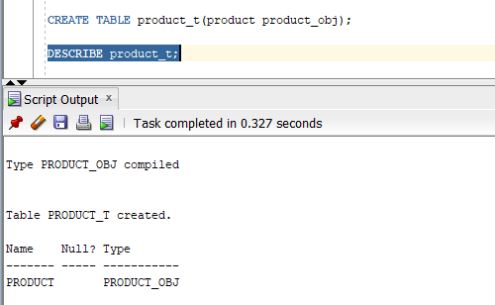
ORDBMS Cont.
Describing product_t;
CREATE TABLE product_t(product product_obj);

Slide 18
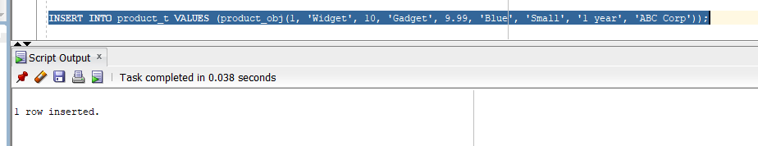
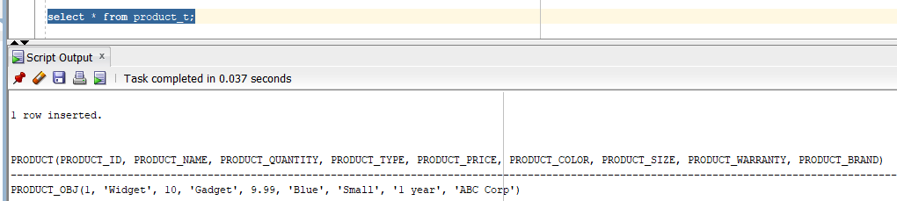
ORDBMS Cont.
INSERT INTO product_t VALUES (product_obj(1, 'Widget', 10, 'Gadget', 9.99, 'Blue', 'Small', '1 year', 'ABC Corp'));
select * from product_t;

Slide 19
LESSONS LEARNT FROM PROJECT DEVELOPMENT
Planning: Adequate planning is essential for the success of any project. The project team must have a clear understanding of the project goals, timelines, resources required, and potential risks and challenges.
Communication: Effective communication between team members, stakeholders, and customers is crucial to ensure that everyone is on the same page and any issues or concerns are addressed promptly.

Slide 20
ROOM FOR IMPROVEMENT
We would like to focus more on the ORDBMS code and would like to learn more about it.
We would also love to develop a unique and simplified ER diagram and code.

Slide 21

THANK YOU

